Slide 1
Website Design
Reece Davies

Slide 2
Landing page - Home

Slide 3



LOGO
Home About Memberships Contact
WALLPAPER PHOTO
SLOGAN
PHOTO
PHOTO
TITLE OF OFFER
TITLE OF OFFER

Slide 4

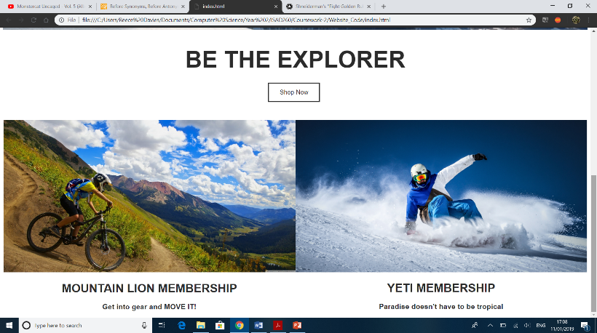

Slide 5
(ABOUT)

Slide 6
LOGO
Home About Memberships Contact
About Us
PHOTO
TEXT DESCRIBING BUSINESS
PHOTO
Additional Information
TEXT

Slide 7
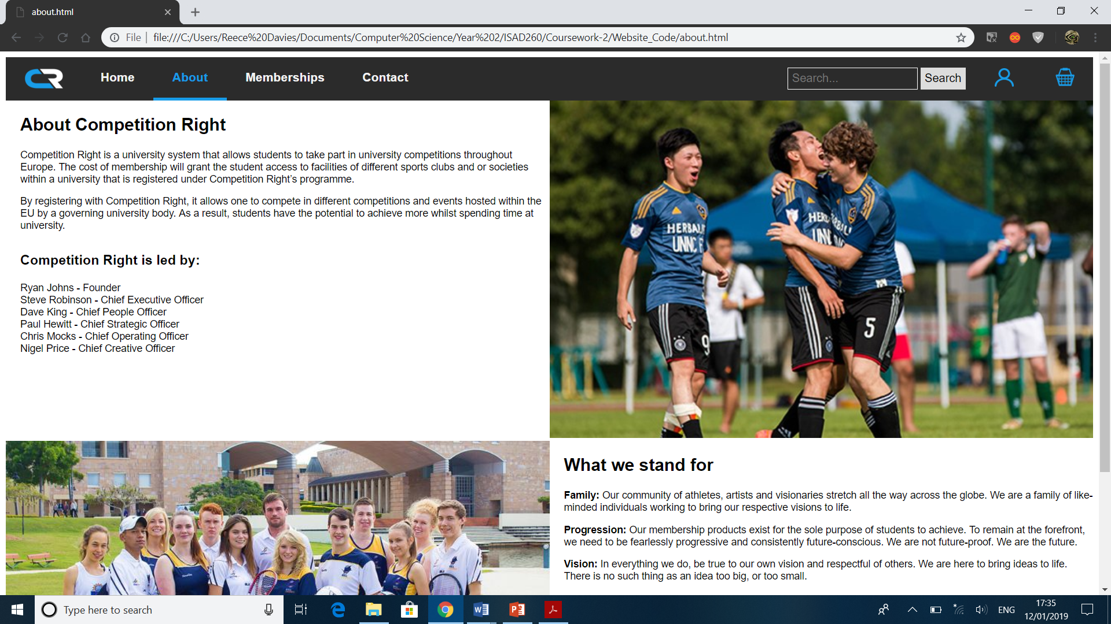
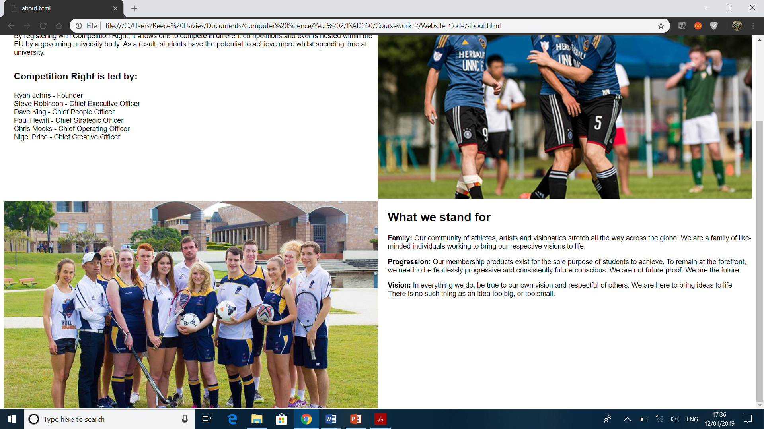

Slide 8
(Memberships)

Slide 9
LOGO
Home About Memberships Contact
All
Popular
New
__________
Indoor
Outdoor
__________
Memberships
Membership photo (with name displayed)
Membership photo (with name displayed)
Membership photo (with name displayed)
Membership photo (with name displayed)
Membership photo (with name displayed)
Membership photo (with name displayed)
Membership photo (with name displayed)
Membership photo (with name displayed)
Membership photo (with name displayed)
Membership photo (with name displayed)
Manage Memberships
Change billing details

Slide 10
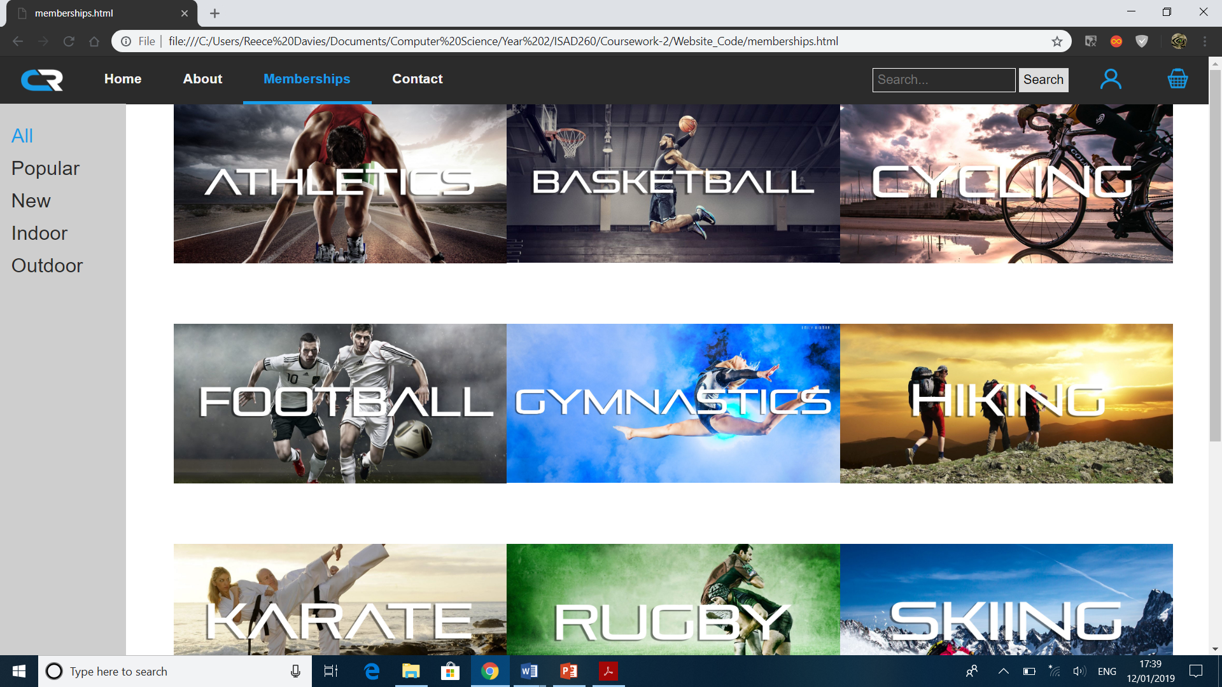
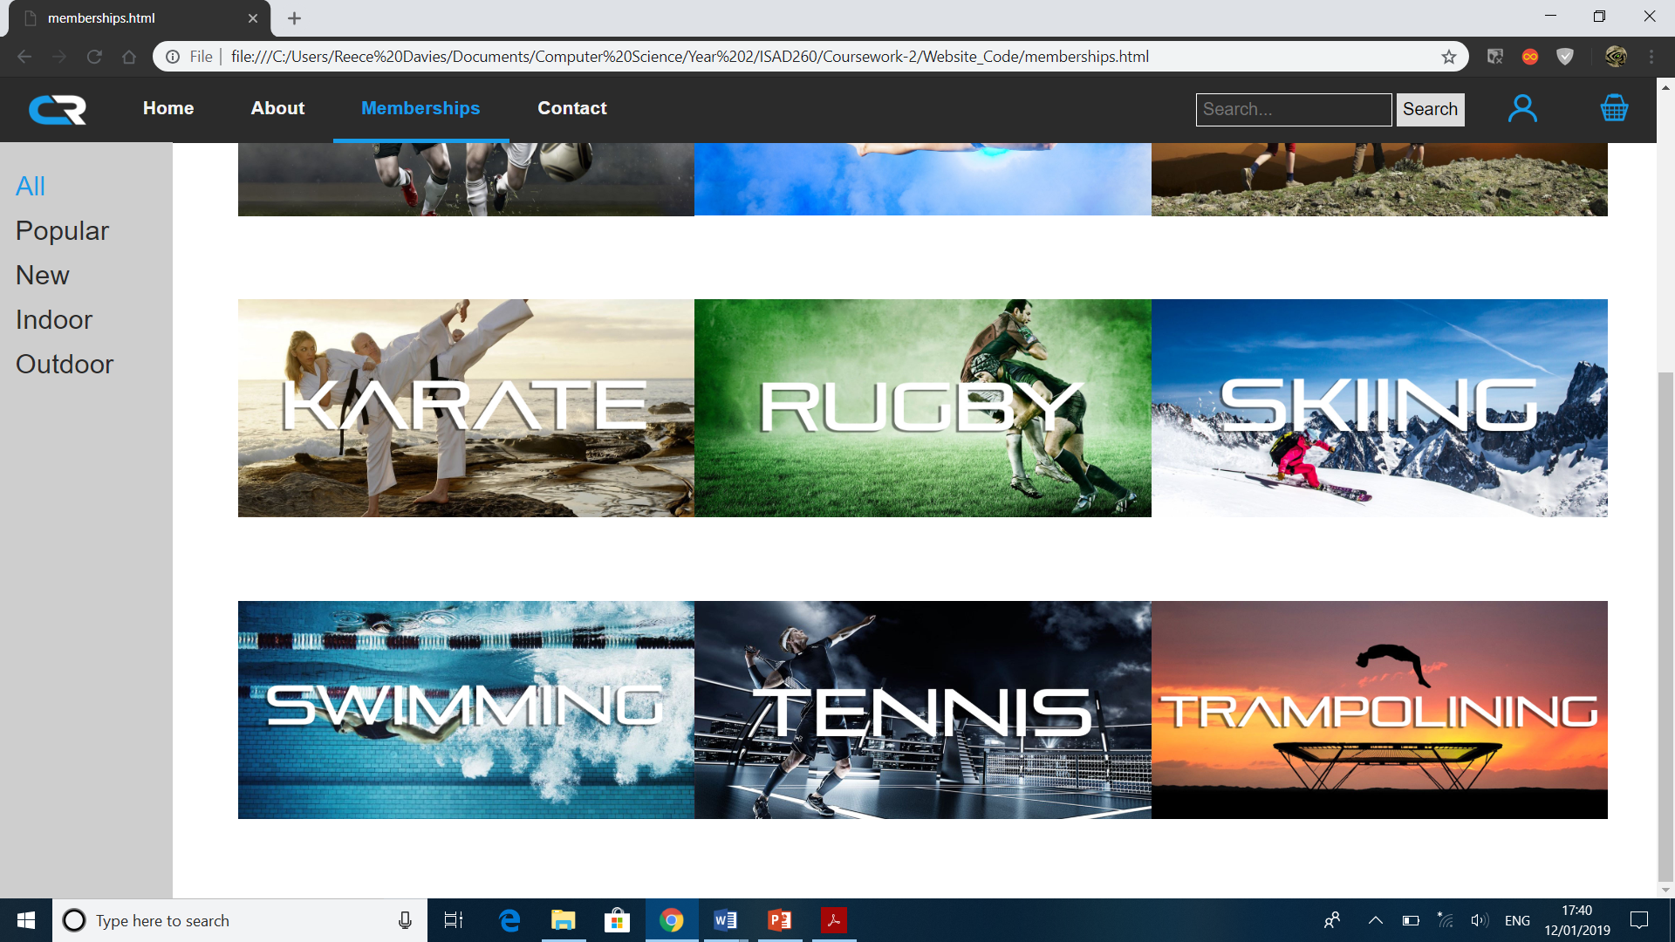

Slide 11
(Contact)

Slide 12
LOGO
Home About Memberships Contact
CONTACT US
MAP
PHOTO
ADDRESS

Slide 13
MAP
PHOTO
ADDRESS
CUSTOMER SERVICE ENQUIRIES
CAREER ENQUIRIES
SOCIAL MEDIA

Slide 14
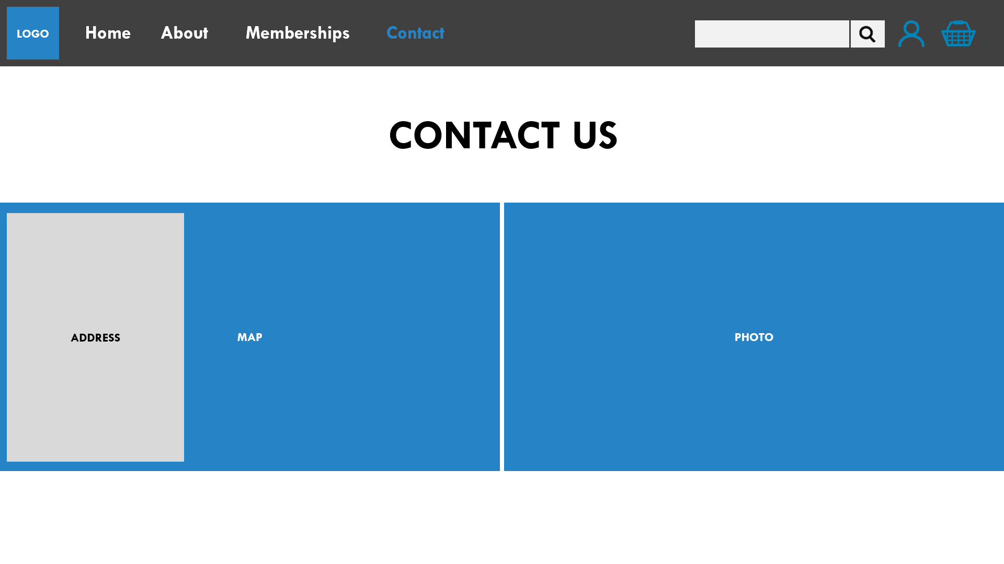
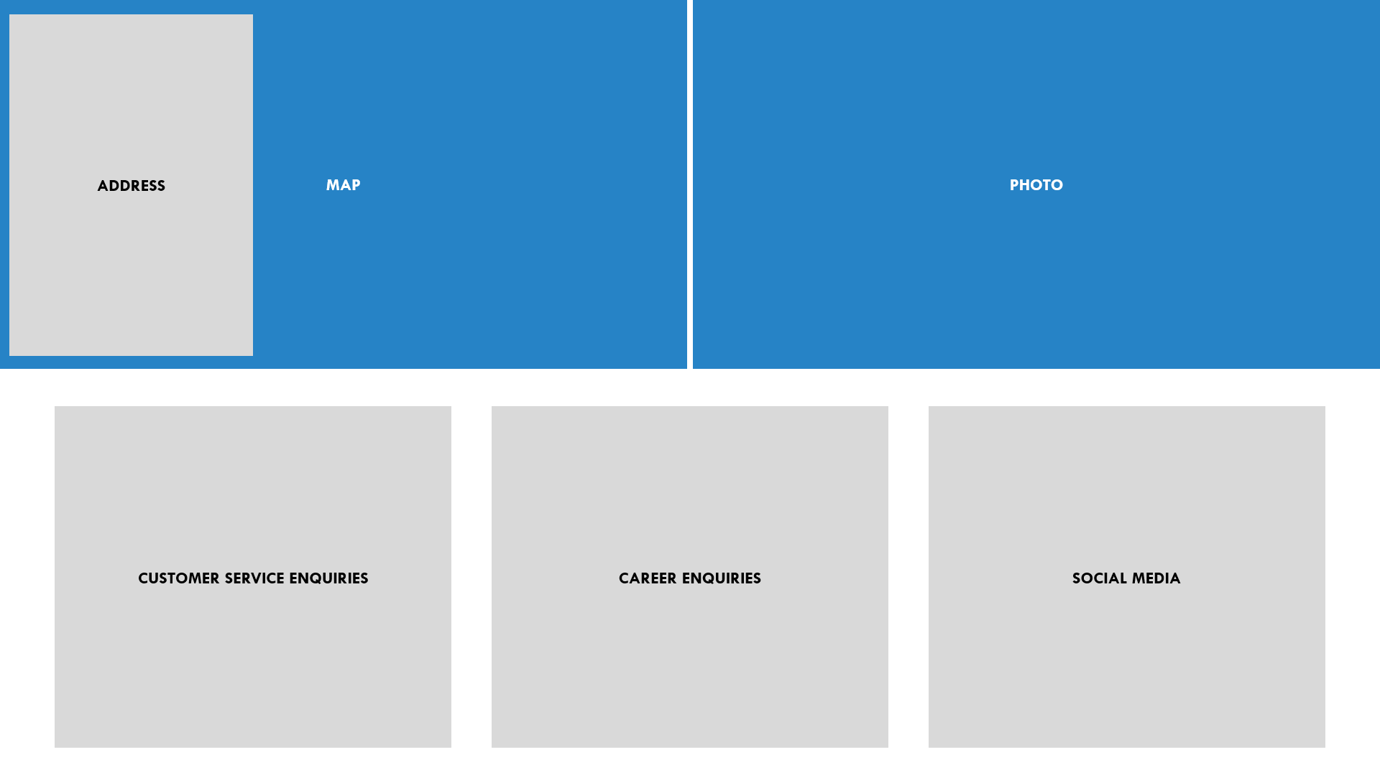

Slide 15
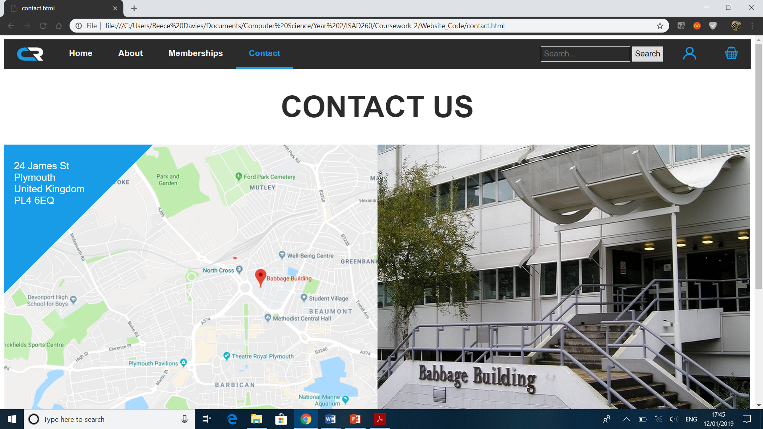
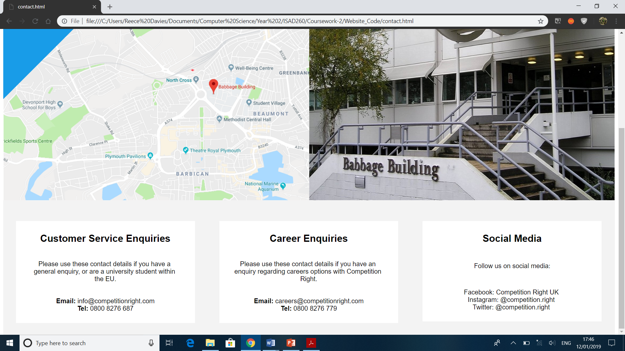

Slide 16
Login interface

Slide 17

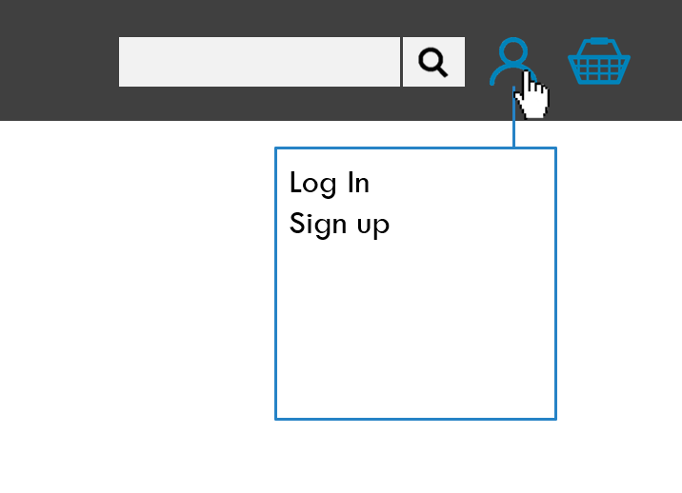
LOGO
Home About Memberships Contact
Log In
Sign up

Slide 18
LOGO
Home About Memberships Contact
Welcome back
Username:
Password:
Remember me Forgot your password?
Log In
Don’t have an account? Create One

Slide 19
LOGO
Home About Memberships Contact
Nice to have you with us
First name:
Last name:
Username:
Confirm Username:
Email:
Confirm Email:
Password:
Confirm Password:
Create Account

Slide 20
Secure page

Slide 21
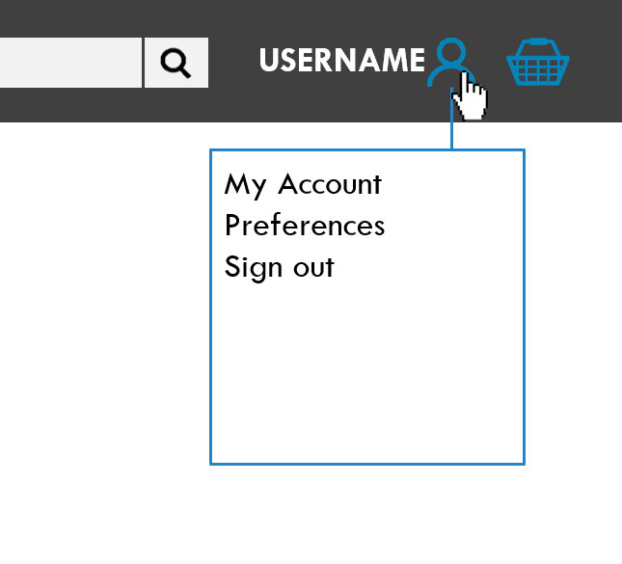
LOGO
Home About Memberships Contact
USERNAME
My Account
Preferences
Sign out

Slide 22
LOGO
Home About Memberships Contact
USERNAME
Account information
Active memberships
Name: Troy Williams
Username: TWilliams
Email address: troy.williams@students.Plymouth.ac.uk
Account status: Active
Address: 23 Example road, Plymouth, United Kingdom, PL82DY
Membership photo (with name displayed)
Expiration date
Monthly cost
Membership photo (with name displayed)
Expiration date
Monthly cost
Manage Memberships
Change billing details
Expired memberships
Change Account Details
Forgot Password
Membership photo (with name displayed)
Date expired
Manage Memberships
Change billing details

Slide 23
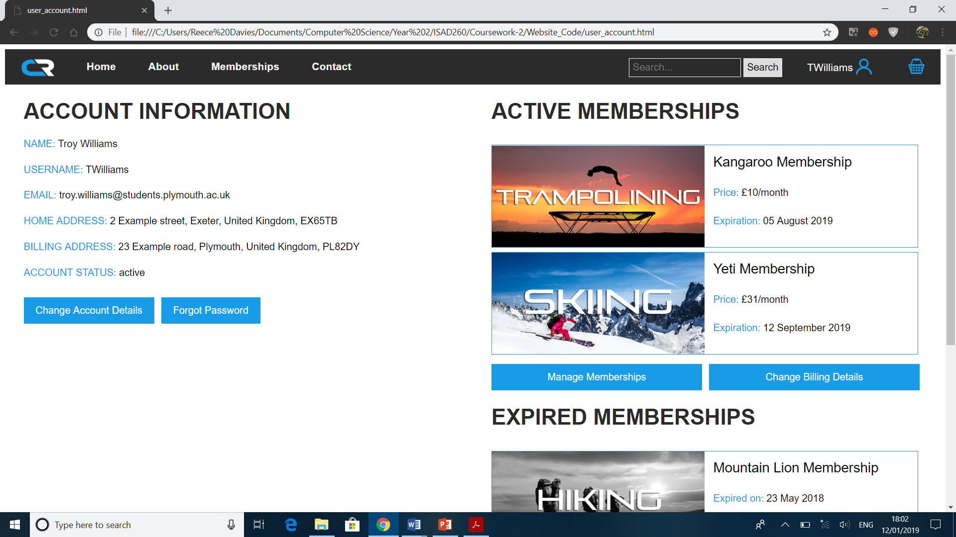
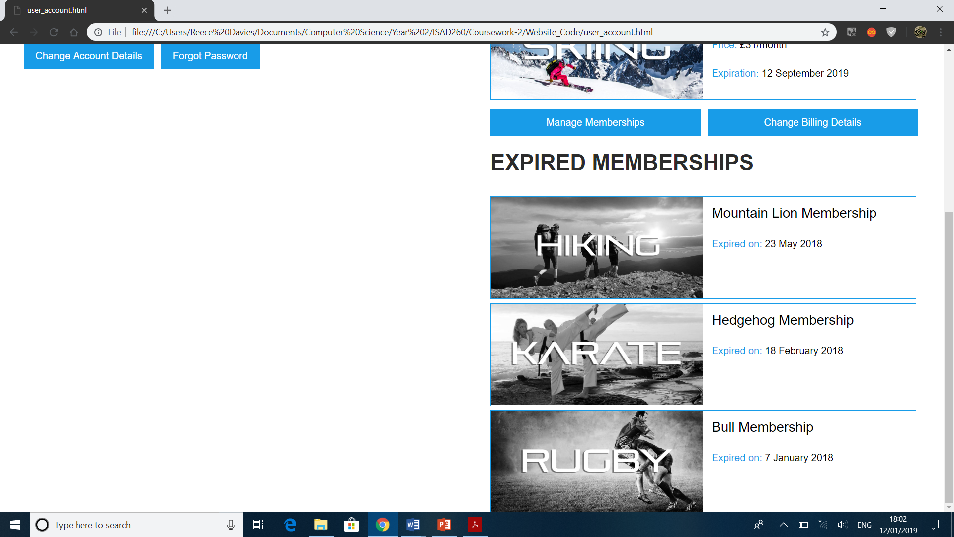

Slide 24
Error handling

Slide 25
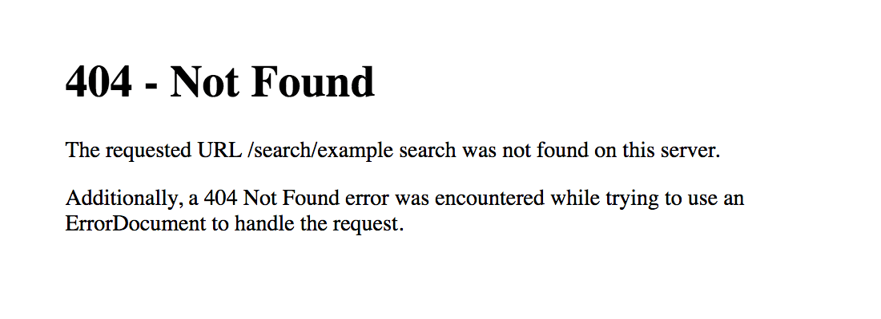
LOGO
Home About Memberships Contact
Manage Memberships
Change billing details

Slide 26
Pages relation

Slide 27
Home
About
Memberships
Contact
Login
Create account
Logs in
Creates account
Account details
Signs out
Personal preferences
Cart

Slide 28
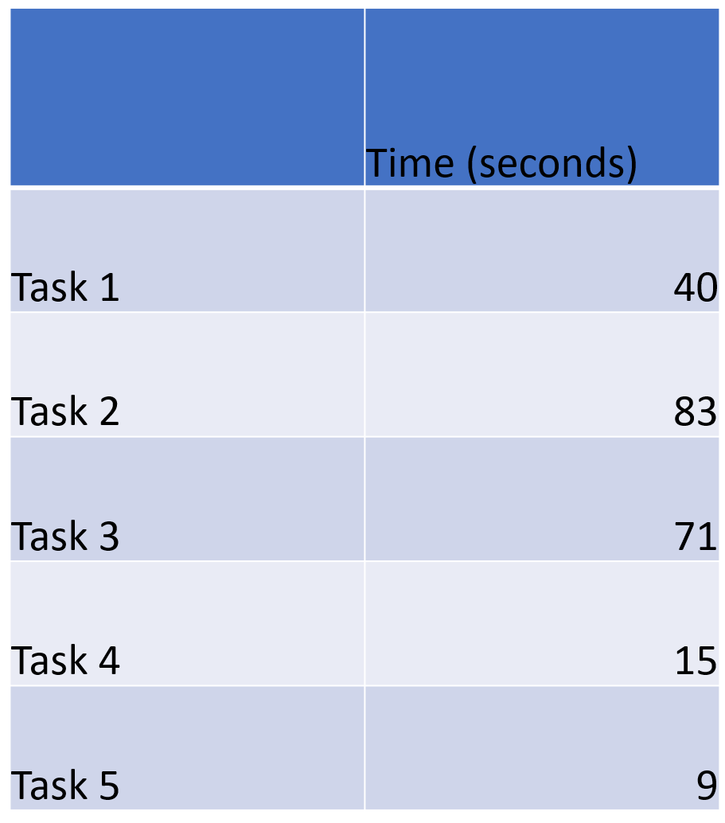

Slide 29
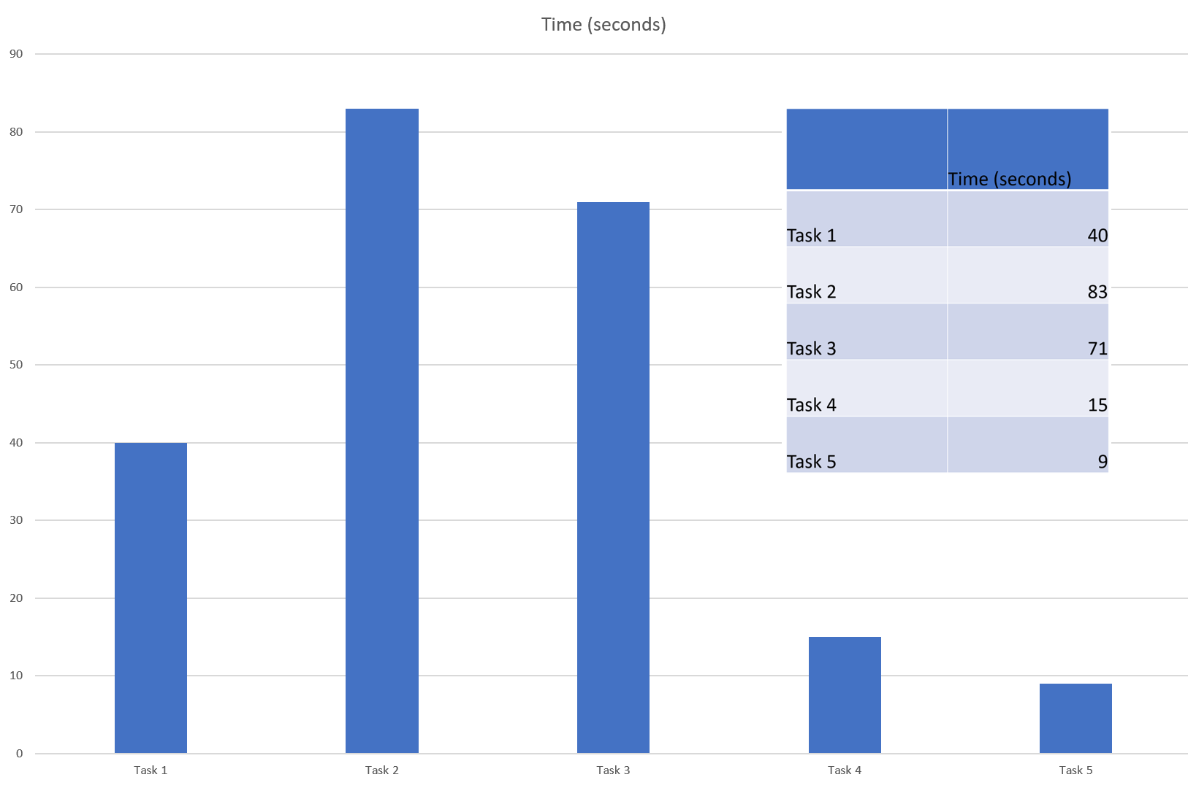

Slide 30
 | Time (seconds)
Task 1 | 40
Task 2 | 83
Task 3 | 71
Task 4 | 15
Task 5 | 9

